Slide 1
RAILWAY STATION BUSINESS LOCATION SCOUTING - london
IBM DATA SCIENCE CAPSTONE PROJECT
DAVID SACKEY

Slide 2
INTRODUCTION
We are accustomed to seeing stores and other forms of businesses in airports, be it duty free stores and restaurants/bars. Train stations on the other hand, do not have the space to have such establishments within the train station.
With some high-street stores across London announcing plans to open new branches in the immediate vicinity transport hubs - particularly, railway stations, it is prudent to analyse the kinds of businesses operating in the area. This decision to expand to railway stations is partly as a result of increasing passenger journeys each year for the past 20 years.
An analysis of most visited businesses close to railway stations will help some companies or individuals decide on how to take advantage of the yearly increase in passenger traffic.

Slide 3
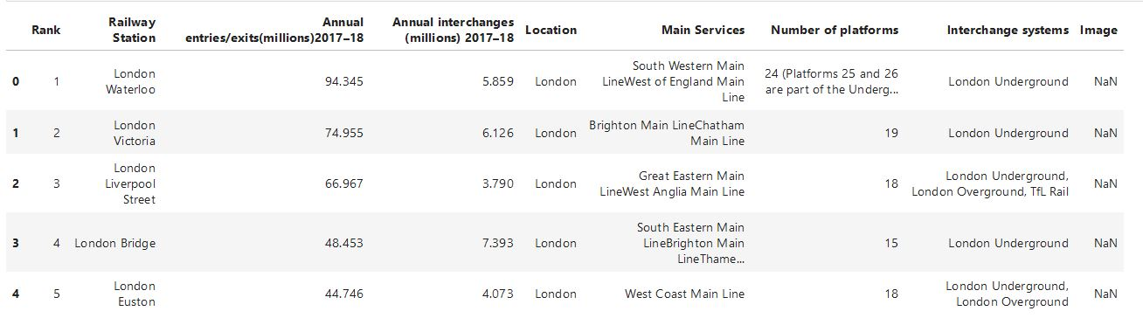
DATA
Primary data used in analysis is from Wikipedia – ‘List of busiest railway stations in Great Britain’

Slide 4
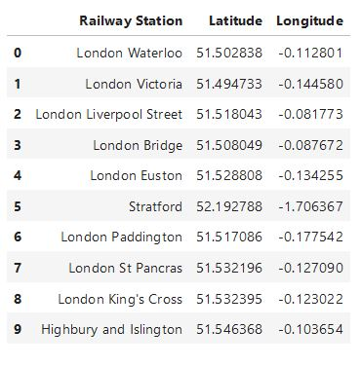
DATA
Railway stations in London are pulled through and stored in a new dataframe.
A function is written to obtain the coordinates of all the railway stations of interest using ‘geopy.geocoders’
The coordinates are merged to the dataframe containing the list of railway stations to form a complete table.

Slide 5
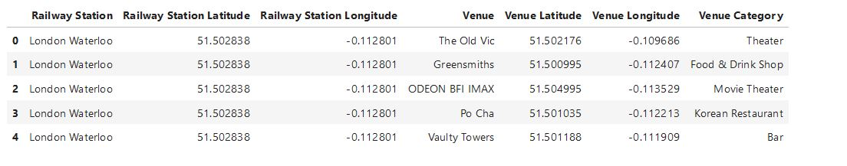
METHODOLOGY
A function written to return a list of 100 venues within 500 metres of each of the 10 busiest railway stations in London yielded 705 results.

Slide 6
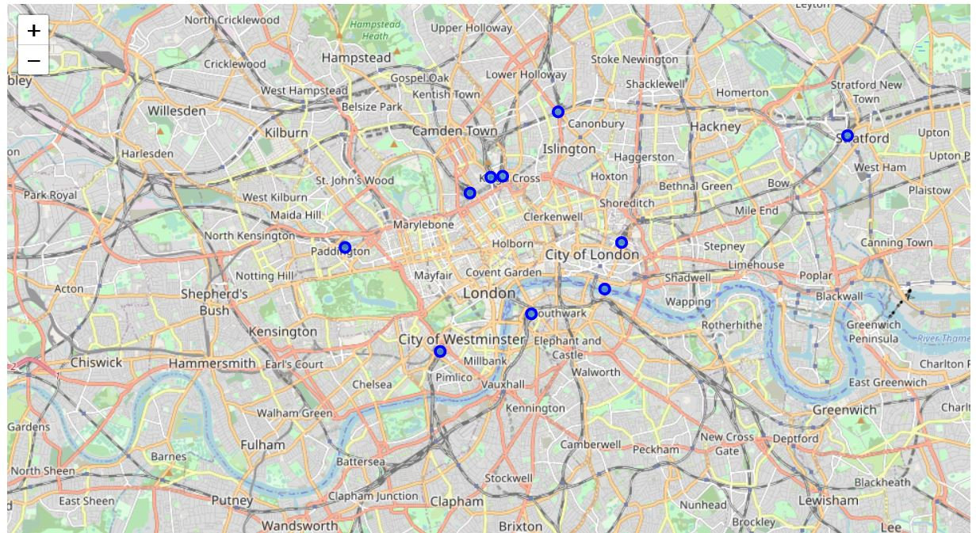
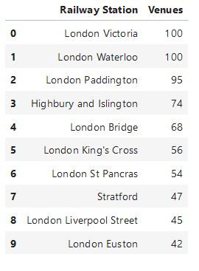
METHODOLOGY
The location of the railway stations are shown on a map of London. The railway stations and the total number of venues returned for each station is shown in a dataframe.

Slide 7
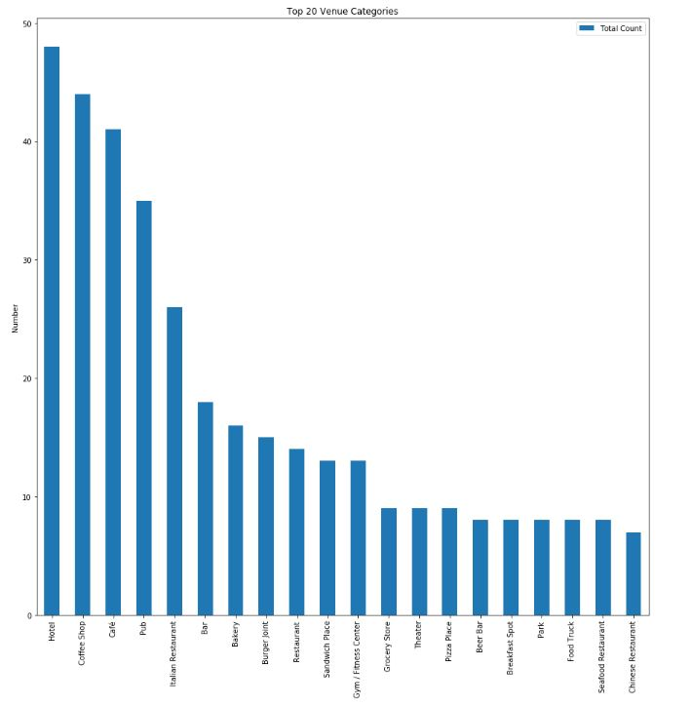
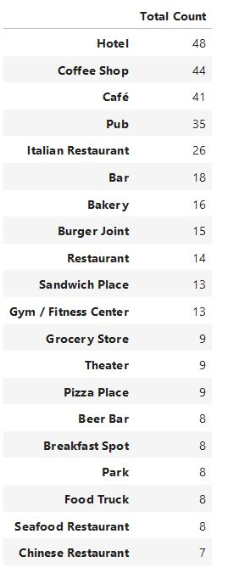
METHODOLOGY
The total number of venues for the top 20 categories for all railway stations is shown in the bar plot along with the dataframe.
From the plot, it is observed the top 3 business close to railway stations are hotels, coffee shops, and a café.

Slide 8
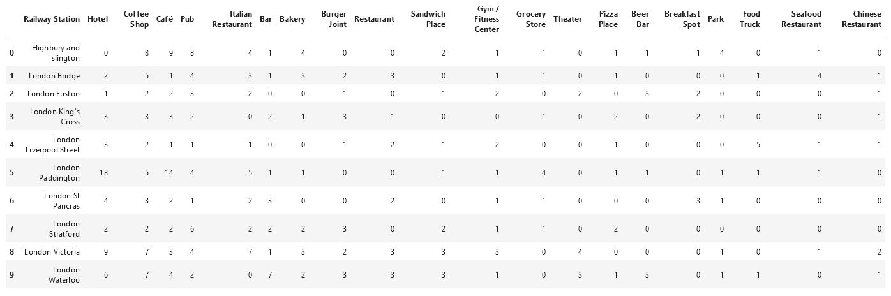
RESULTS
The table above shows the breakdown of the top 20 venue categories for the ten railway stations of interest.

Slide 9
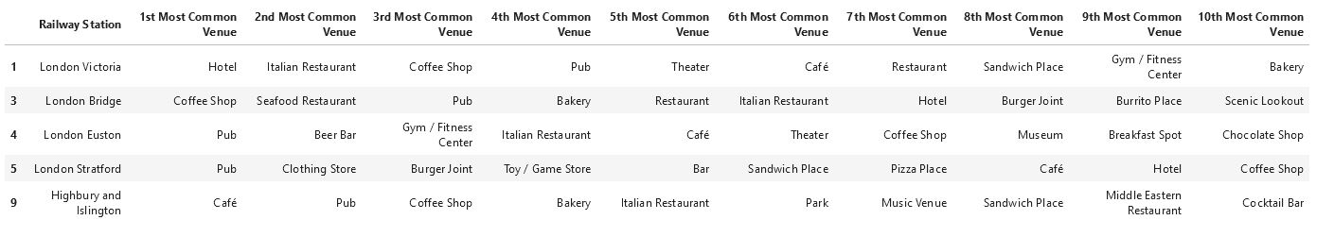
RESULTS
Cluster 1
Main characteristics of cluster 1 include hospitality, and recreational venues
Cluster 2
Main characteristics of cluster 2 include hospitality venues, recreational venues, fitness locations, and stores

Slide 10
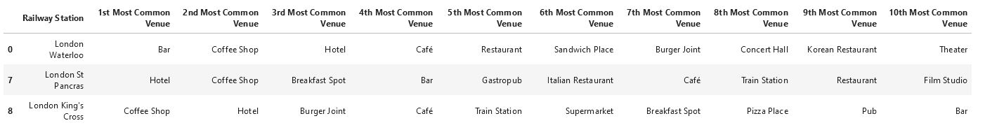
RESULTS
Cluster 3
Main characteristics of cluster 3 are hospitality and fitness venues.
Cluster 4
Main characteristics of cluster 4 are hospitality, recreational, and transportation venues

Slide 11
CONCLUSION
Individuals/ businesses looking to start a business close to any of the top ten busiest railway stations can get an idea as to the other business in the vicinity. Any opportunities can be exploited.
An advantage of this analysis shows the clusters for the railway stations based on similar characteristics – types of business – that can help one decide on the best location for a business.

